Slide 1
TCS INTERNSHIP PROJECT -
CREDIT RISK MODELLING
TEAM MEMBERS TEAM MENTOR
PAVAN KUMAR REDDY K - 2309356
DHARANITHARAN I- 2306999
SANJEEV KUMAAR M - 2307112
DEBASHISH JANA

Slide 2
DATA SOURCE - REFERENCE
PROBLEM STATEMENT
To develop a model which would forecast the loss based on the behaviour of customers’ historical transactions and Macro Economic Variables.
> FREDDIE MAC ORIGINATION AND MONTHLY PERFORMANCE FILE DATASET
https://www.freddiemac.com/research/datasets/sf-loanlevel-dataset
> MACRO ECONOMIC DATA SOURCE - FRED ECONOMIC DATA ON UNEMPLOYMENT RATE
https://fred.stlouisfed.org/series/UNRATE#
> MACRO ECONOMIC DATA SOURCE - FRED ECONOMIC DATA ON HOME PRICE INDEX
https://fred.stlouisfed.org/series/CSUSHPINSA

Slide 3
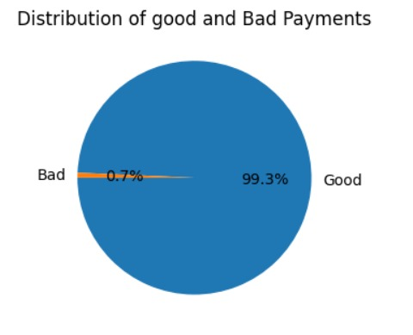
Exploratory Data Analysis - Distribution of Defaults
According to the data collected from 2018 - 2020 period ,it has been found that a very little fragment of the loan buyers had a very bad performance rating and fallen into the default list.

Slide 4
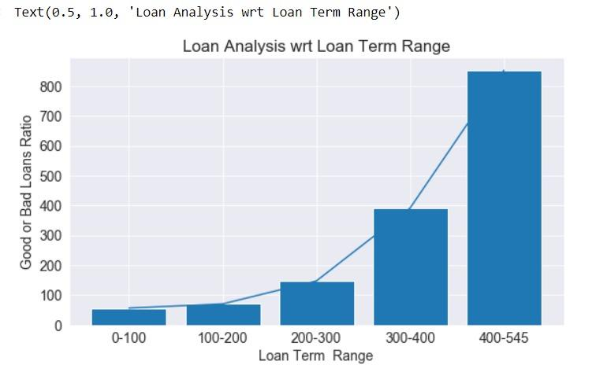
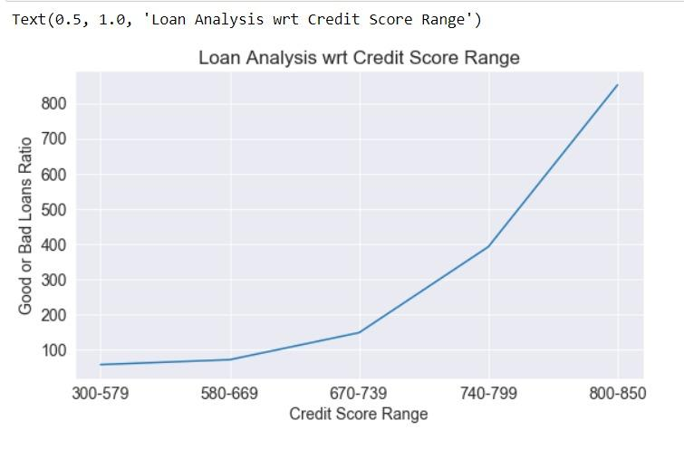
Exploratory Data Analysis - Origination Factors
Loan Term always plays a timely factor in analysis and focuses on depicting the performance ratio depending upon the flexibility of the Loan term.
Credit Score plays an important role in drafting the buyers potential in payback process ,while according to the analysis buyers having higher credit score shows better performance.
(With the help of the ratio between good and bad performed loans ,it is easy to depict the analysis for each factor such as Loan-age , Credit Score , DTI ratio etc;)

Slide 5
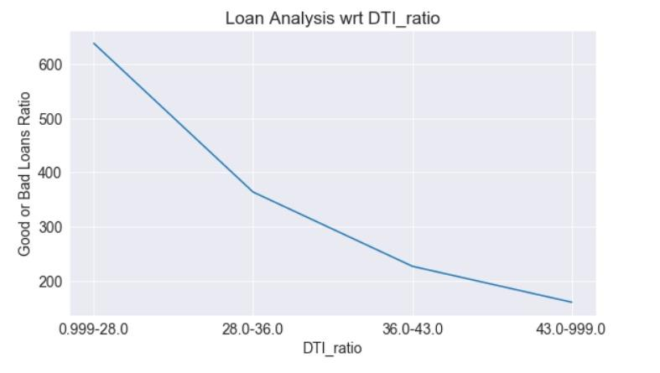
Exploratory Data Analysis - Origination Factors
Debt to income ratio gives out a clear picture on individual’s capability on managing monthly payments and clearing debts.

Slide 6
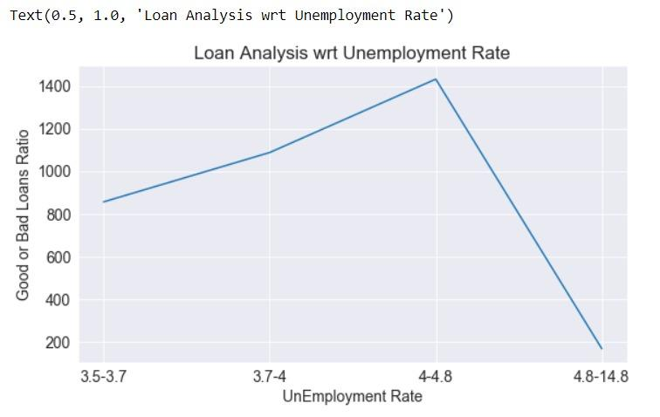
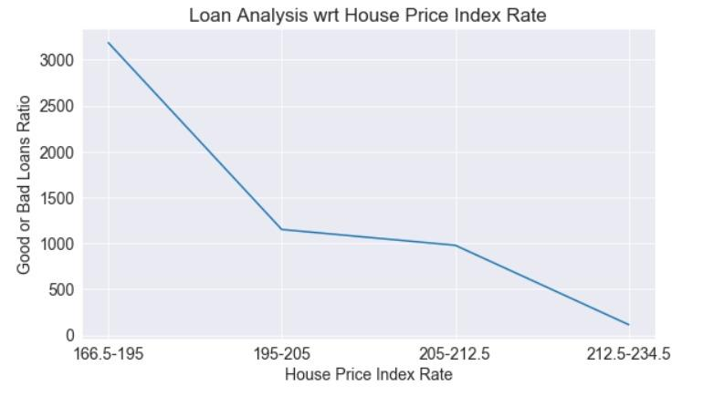
Exploratory Data Analysis - Macro Economic Variables
Unemployment Rate has a large effect on the default rate.
HPI index directly proportionate towards default rate.

Slide 7
Final Variable Selection
Merging of files
Exploratory Data Analysis
Weight Of Evidence /
Information Values
Origination and Monthly Performance files from the year 2018 to 2020 were merged
Univariate and Multivariate analysis were made to find the pattern it follows over the years.
Comparison were made in between the variables and to find their strength values for predictive analysis.

Slide 8
Final Variable Selection
Variable
Description
Credit Score
Explains credit worthiness of the loan buyer
Orig_LTV
Property value that a bank can lend to the property buyer
Curr_interest_rate
Depicts the clear insight about the monthly performance
UNRATE
Unemployment rate is a macro-economical factor
CSUSHPINSA
Change in the value of the U.S. residential housing market
Orig_loan_term
Number of payments of the mortgage based on first payment date

Slide 9
PD Model Building Flowchart
Final Variable Selection
1
3
5
Test and Train Dataset
2
Logistic Regression Model
3
Accuracy Measurement
4
Validation
5

Slide 10
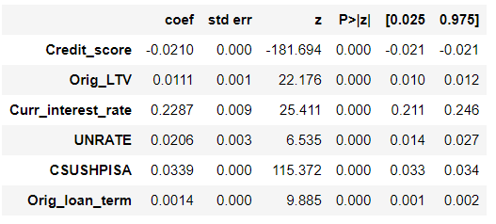
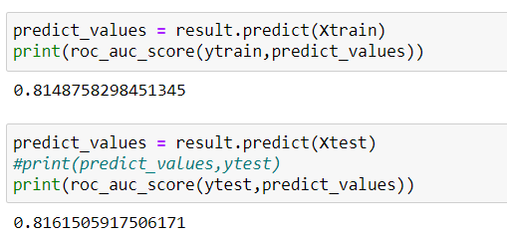
PD Model Building and Results
Summary
For splitting our dataset with respect to loan sequence number, we used group shuffle split in the ratio of 80:20 where 80% of our data has been used for training and 20% has been used for testing.
Statistical Method - Logistic Regression technique has been used to forecast the probability of default.
Model Score
All the p-values are less than 0.05, hence all the variables are significant
All the sign of beta coefficient are aligned with business expectation.
The training and testing dataset has achieved an accuracy score of 81.48% and 81.61% respectively

Slide 11
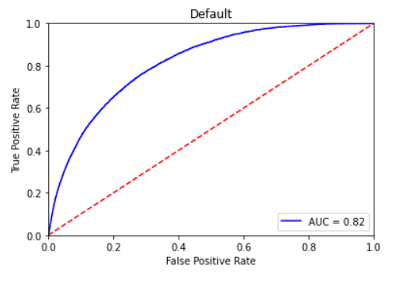
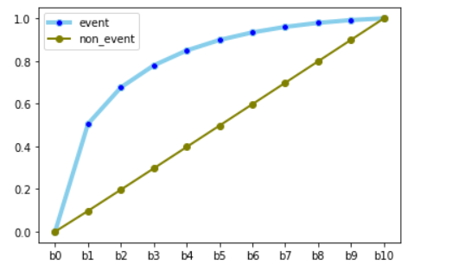
Model Validation - AUC & KS Test
Area under the ROC Curve (AUC) is an evaluation metric that considers two parameters TPR vs. FPR and measures the quality of our model's predictions
The model has AUROC of 0.82, hence it has good predictive power.
Kolmogorov–Smirnov (KS) compares the cumulative distribution of events and non-events. It tells how well our predictive model is able to discriminate between events and non-events.
Since here KS is 0.5 , so there is a good separation between events and non-events.

Slide 12
Q&A

